Slide 1

E-SHOP
FOR CLIENTS TO FIND THE LATEST FASHION AND EXPENSE MANAGEMENT

Slide 2
TEAM
CHRISTINE ARENG
GABEL
FELIX MANYARAFELLOWX@GMAIL.COM

Slide 3
WHAT WE ARE TRYING TO SOLVE.
CONNECTING WITH THE YOUTH AND FASHION DESIGNERS .
TRACKING UPDATES TO TERMS OF-USE AGREEMENT.
CONNECT WITH CLIENTS TO MAKE THEIR MONEY GROW
TO HAVE A CLEAR FINANCIAL GOAL
PROBLEMS IDENTIFIED
CUSTOMERS DO FIND IT HARD TO MANAGE THE LITTLE MONEY THEY HAVE BEFORE DOING ONLINE PURCHASES.
CLASSY/TRENDY CLOTHES TAKE TIME TO THE KNOW HOW OF THE CUSTOMERS,REASON WHY WE HAVE STEPPED IN TO BRING FORTH A PLATFORM TO EASILY MANAGE IT.

Slide 4
SOLUTIONS TO PROBLEMS.
FREELANCE ATTORNEYS-COLLECT INFORMATION FROM BOTH PARTIES TO MAKE BEST MATCH QUICKLY.
TRACK(CLIENTS) EACH VERSION OF ONLINE USER AGREEMENT.
LIKE AGGREGATE LAW (CONNECT WITH AGENT LEGAL NEEDS).
CREATION OF A WEBSITE WHERE THESE TWO PARTIES CAN INTERACT AND SHARE LEGAL LAW MATTERS.
FOR CLIENTS BE ABLE TO KNOW WHERE TO GET LEGIT LEGAL ADVISORS AND WHO CAN REPRESENT THEM IN COURT OR ANY CRIMINAL CASES/TRIALS.

Slide 5

PROJECT DEMO
CLASSY SHOP AND
EXPENSE TRACKER

Slide 6
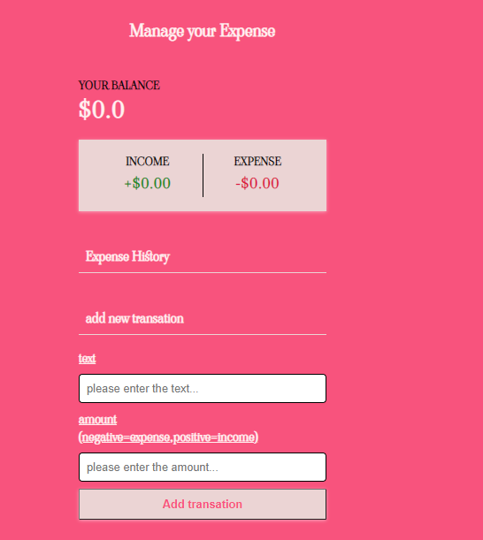
PROJECT DEMO
CLASSY SHOP AND
EXPENSE TRACKER

Slide 7
TECHNOLOGY USED TO FULFIL THE PROJECT
USED INVISIONAPP.COM FOR DESIGNING THE PROJECT.
ALSO USED FIGMA FOR DESINGING THE PROJECT.
HTML –FOR THE STRUCTURE OF THE WEBSITE.
CSS –FOR THE LAYOUT OF THE PROJECT.
JAVASCRIPT

Slide 8
CHALLENGES EXPERIENCED IN THE PROCESS OF DEVELOPMENT.
MAKING THE WEBSITE FUNCTIONAL.
GETTING STRAINED BY SMALL CLAIMS.
SPENDING MUCH TIME IN ENABLING THE EXPENSE MANAGER TO WORK

Slide 9
FUTURE PLANS.
TO USE BACKENDED PLATFORM TO MAKE THE SITE FULLY FUNCTIONAL.
ENABLE THE CLIENTS WHERE THEY CAN CREATE THEIR ACCOUNT A FULL ONE TIER CUSTOMER ACCOUNT
MAKE CHATBOT WHERE SALES REPRESENTATIVE CAN INTERACT WITH CUSTOMERS FOR SUPPORT AND FINANCIAL ADVICE.
TO ENABLE LOCATION TRACKER AND REAL TIME MESSAGING TO THE CUSTOMERS ONCE A PURCHASE IS SUCCESSFULL

Slide 10
THANK YOU
ANY QUESTIONS.

